Slide 1

CUSTOMER RETENTION ANALYSIS
FOR INDIAN E-COMMERCE WEBSITES
Submitted by:
Deepika

Slide 2
CONTENTS
Introduction.
What is Customer Retention and its benefits.
Tools, Dataset and Assumption.
Analysis.
The main factors that drive customer Retention.
Conclusion.
Limitations and Scope for future work.

Slide 3
INTRODUCTION
Through this slides we will be looking at the analysis made on the customer retention rate for Indian e-commerce companies.
We will be analysing the retention rate with the help of a survey answered by e-commerce customers on online retail companies and the factors that influence their purchase decision.
We will also be looking at the expectations of the customer on a good e-commerce website.

Slide 4

WHAT IS CUSTOMER RETENTION?
Customer retention means the process of maintaining or keeping customers once you have acquired them. It’s all the activities that a company must do in order to keep their customers around. The goal is to build a long-lasting relationship between the brand and consumers. Once a customer becomes loyal to your brand, not only he will buy more from you than a normal customer but he’ll spread good words about your business, increase your reputation.

Slide 5

THE BENEFITS OF CUSTOMER RETENTION:
Improve Conversion Rate.
Old Customers Buy More.
Reduce Marketing Cost.
Get More Feedback From Engaged Customers.
Word of Mouth – Referral Marketing.

Slide 6
DATA AND ASSUMPTIONS
The gathered data contains 269 surveyors and 47 answers from each one of them
We have asked questions and recorded answers on 4 major categories.
The basic information of the population.
How was the online purchase made.
Important factors for making purchase decision and drives satisfaction.
Which e-commerce sites satisfies the above factors to make purchase decision and drives satisfaction.
The Assumption for this analysis is that, when we recommend something to a friend, it is most likely that we are using it, we will be using it in future and we are satisfied with the service/experience we’ve received.

Slide 7
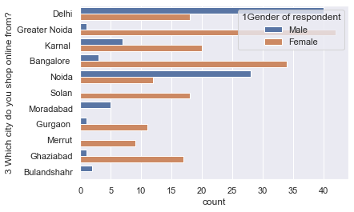
ANALYSIS
The Analysis is for the Indian e-commerce websites and the survey was randomly made from the buyers of different cities of India.

Slide 8
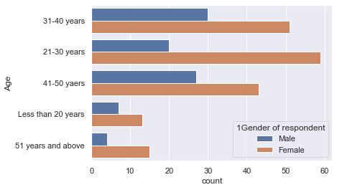
The population data consists of surveys from both male and female buyers from all age ranges, which is used to determine the factors that influence the customer retention rate.

Slide 9
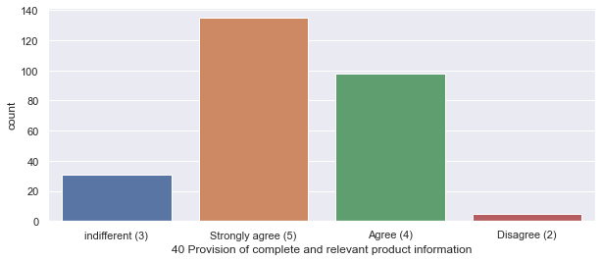
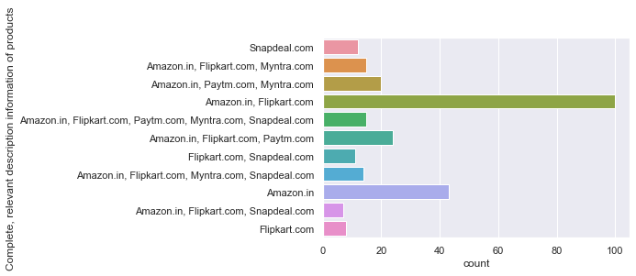
*Here, we are comparing the buyer’s expectation in any e-commerce website (Online Shopping Platform) with the actual companies which meet their expectations. *It is important for the companies to display all relevant information on listed products. *Most of the buyers believe Amazon and Flipkart provides this experience.

Slide 10
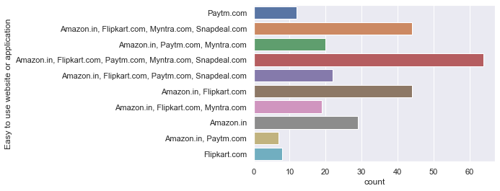
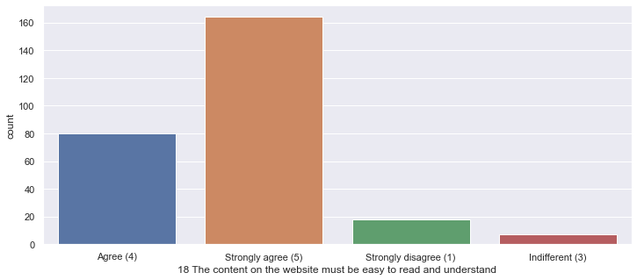
-Most of the buyers believe that the content on a e-commerce website must be easy to read and understand. -Here the expectations of the buyer is met by almost all the company, however the majority population mentioned Flipkart and Amazon.

Slide 11
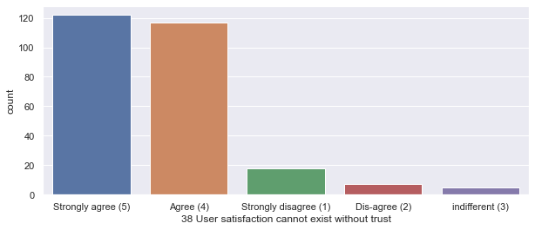
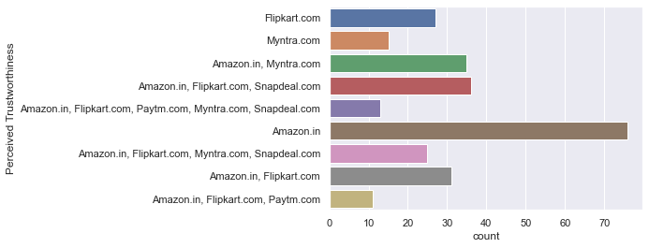
-Buyers believe that the user satisfaction cannot exist without trust in an e-commerce website. -Here we can clearly see from the above graphs, Amazon tops the list for the trust they have gained among the buyers.

Slide 12
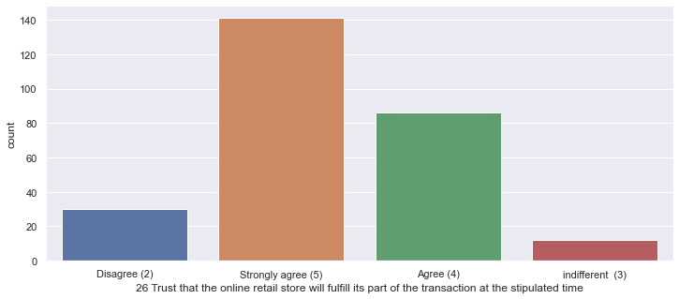
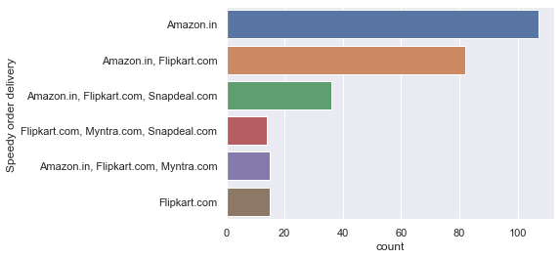
-Buyers trust that online retail store will fulfill its part of the transaction at the stipulated time, which is delivering products on time. -Buyers believe that Amazon and Flipkart deliver the order faster than other e-commerce website.

Slide 13
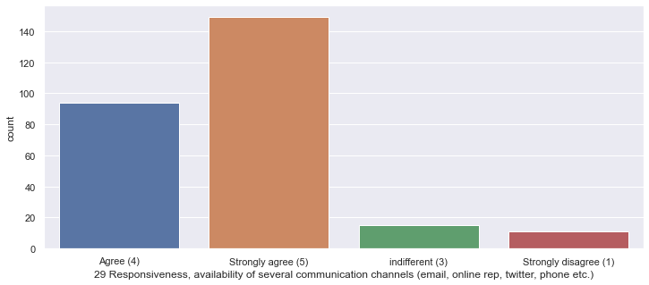
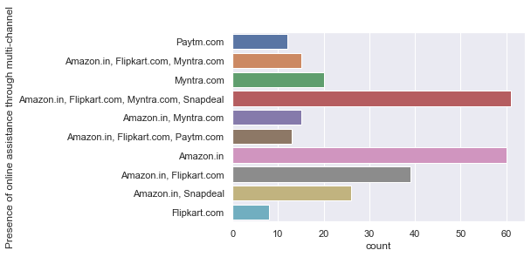
-Buyer’s prefer to have availability of online assistance through multiple channels in order to buy with confidence. -When it comes to availability of online assistance to multiple channels, Flipkart and Amazon tops the list.

Slide 14
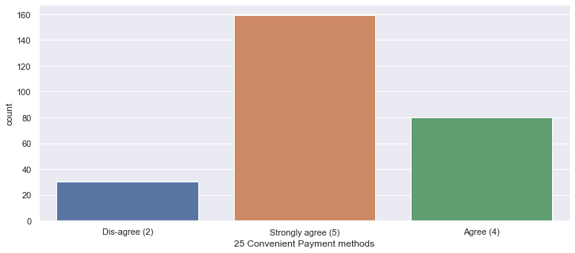
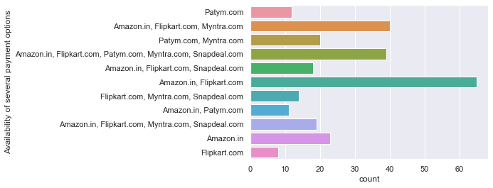
-Availability of more options in communication channels for customer support is very important and most of the buyers agree to it because Customer service is the support you offer your customers — both before and after they buy and use your products or services — that helps them have an easy and enjoyable experience with you. Offering amazing customer service is important if you want to retain customers and grow your business. -Offering multiple payment options can scale-up your conversion by a significant margin and improve customer satisfaction. The more options you provide, the more comfortable users will feel during checkout. When you accept more customers' preferred payment method you will make more sales. We live in a culture of convenience where people don't have the patience for inefficiencies, no matter how small they may seem. A customer will be more likely to shop at your websites if they have more options. Here when it comes to Availability of several payment options,Flipkart.com and Amazon.in is having the highest no of payment options.

Slide 15
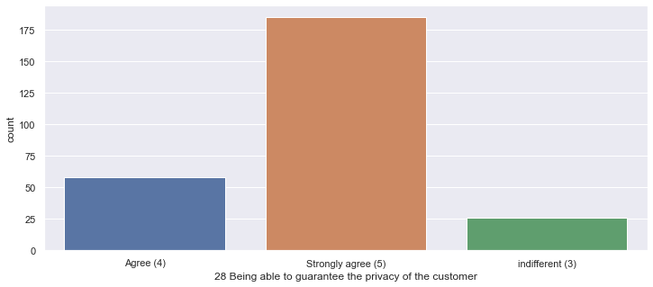
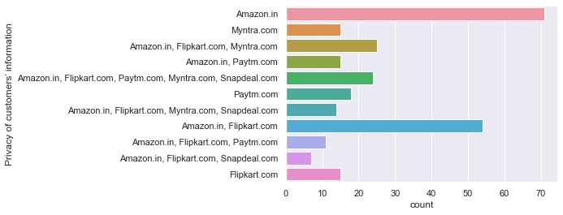
-Most important part according to the buyer is that a e-commerce website should be able to provide complete privacy to its buyers in-order to shop with confidence. -We can clearly see that most of the buyers agree that Amazon and Flipkart are able to provide complete privacy to its buyers.

Slide 16
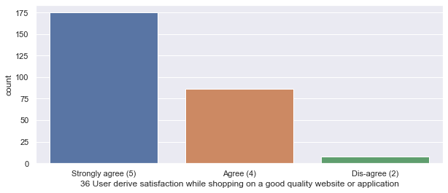
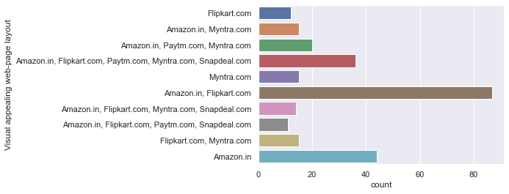
-Buyers believe that a visually appealing website is necessary and it gives a sense of satisfaction when the quality of website is good. -Even when it comes to visually appealing and good quality website, most of the buyers voted for Amazon and Flipkart.

Slide 17
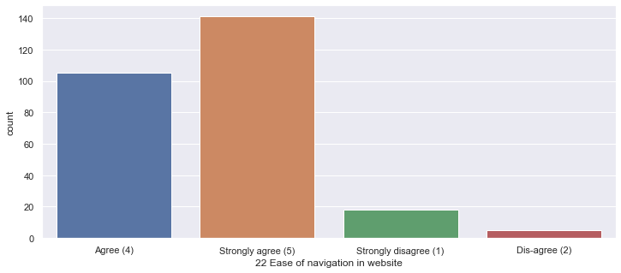
-Buyers believe that ease of navigation is important in a e-commerce website. -Most of the people voted for Amazon.in, Flipkart.com, Paytm.com, Myntra.com and Snapdeal.com that their websites are easy to use.

Slide 18
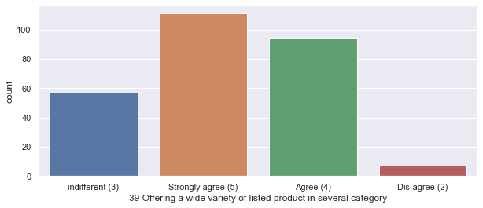
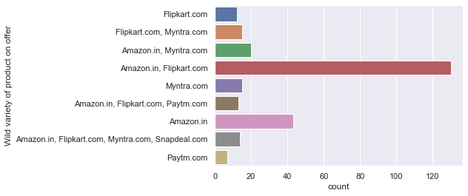
-Buyers agree that a good e-commerce website should offer a wide variety of products over the categories. -As per the answers from the buyers, Amazon and Flipkart are topping the list for offering wide variety of products.

Slide 19
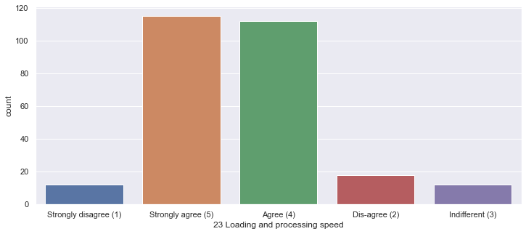
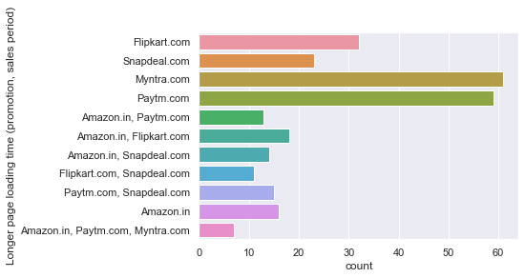
THE E-COMMERCE SITES –DRAWBACKS Buyers agree that the e-commerce sites should offer good processing speed for a better buyer experience, which makes customers to buy from them again. However, the highest number of buyers voted that the sites like Myntra and Paytm fail to offer the same.

Slide 20
-Buyers believed that having convenient payment methods are necessary in a e-commerce website. As we can see most of the buyers voted that Snapdeal and Amazon provided limited payment modes.

Slide 21
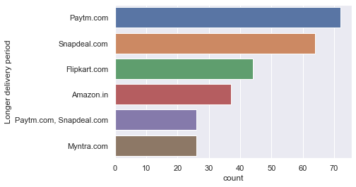
-From the below analysis, we can say that the comparisons between companies that offered quicker delivery of the products and the companies that had longer delivery periods according to the buyers, who believed that receiving the products on time/faster was required to make a purchase decision. Here Paytm and Snapdeal has longer delivery periods.

Slide 22
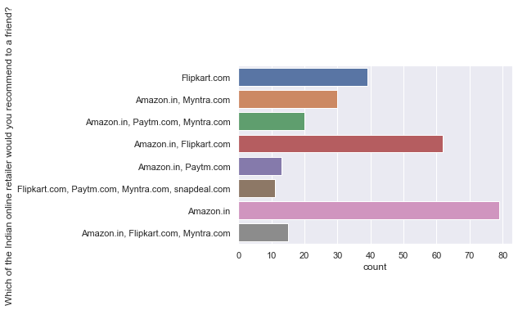
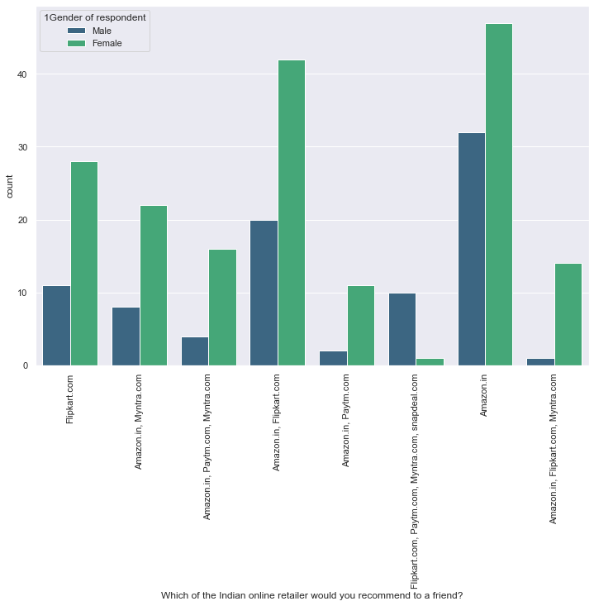
From the analysis till now, I can say that the companies with highest retention and customer satisfaction rates are Amazon.in and Flipkart.com because their positives are line line with the buyer preferences and they are most likely to use this websites for purchases in future. Hence Amazon.in is the highest referable website to there friends and relatives.

Slide 23
THOUGHTS
-Initially we assumed that customers recommend e-commerce websites to their friends, if they are satisfied with the service and they are frequently using the websites for online shopping. -In order to prove that the customer expectations on a e-commerce website should influence the websites they recommend to their friends. -This implies that the websites recommended to their friends should meet the customer expectation and it is highly likely to be re-visited by the buyers for future purchases. -This hypothesis proves that the buyer who recommends a e-commerce site to a friend is the retained buyer of the respective e-commerce companies.

Slide 24
THE MAIN FACTORS THAT DRIVES CUSTOMER RETENTION ARE:
Easy to read and understandable content.
Relevant information on all the products.
Easier website design and navigation.
User friendly Interface.
Convenience in payment methods
Trust and On time delivery.
Better Customer Service.
Secure and offers complete privacy to their customers.
Discounts and Monetary Benefits.
Wide range of options and product selections.
Flexibility in their offers and services.
Return and Replacement policies.
Quality information on websites.
Website Quality.
Value for the money spent.

Slide 25
CONCLUSION
To conclude, having the right customer retention strategy will keep your company grows if you know how to take advantage of it. Your customers will find their way back and continue buying stuff from you. At the end of the day, what you need to do is fulfilling your customers’ needs, listen to their complaints and provide professional solutions. If your customers feel like they are valued, they will become increasingly loyal to your brand. Customer satisfaction is important to win the customer back. There is lot of competition in e-commerce space of retailers hence company should focus in offering the best service.
From the above analysis, I can say that the companies with highest retention and customer satisfaction rates are Amazon.in and Flipkart.com because their positives are line line with the buyer preferences and they are most likely to use this websites for purchases in future.
Most user will recommend Amazon.in and Flipkart to their friends.
snapdeal.com is far behind as only 4.1% of the user will recommend it to their friends.
The company with moderate retention rate is Myntra.com.
Further, the company with very low retention rate and customer satisfaction is with Paytm and Snapdeal because most of the factors are not in line with the customer preferences and they are less likely to use this website again for online purchases or they will hardly refer to there friends.

Slide 26
CONCLUSION
Customer satisfaction plays a major role in retention, A company should first understand what customers expects while purchasing online (e-commerce) and build a better buying experience which will in turn retain the customer. An unforgettable experience is what drives customers to buy again and again.
The interface should be user friendly. There should be complete description of the product on the website or application and it should be efficient to use.
Company should win customer trust that their personal and financial details are secure with us and will not be used for any fraudulent activity.
One of the best way to retain the customer is to have a rewarding loyalty program. Customer should feel invested in the company and they will be happy that every purchase they are making will lead to more rewarding experience.
Any issue while browsing should be addressed. Customer may lose out on the deal if there is some glitches or technical issue with the website. The browsing should be quick especially during the sale or promotion period.

Slide 27
LIMITATIONS OF THIS WORK AND SCOPE FOR FUTURE WORK:
There is one major limitation to the analysis, due to the minimum data there are 50% more female surveyors when compared to male and this margin is huge.
Further the data is very less to come to a sure conclusion on the retention rate. And if we are analyzing the retention, it would be fair to ask the surveyors the direct question on which websites are they are likely to buy from the websites in future.

Slide 28
If any E-commerce sites/application have a great deepen through the above mentioned points, the company will retain customers and it will help to grow the business because there will be lot of referrals awaiting.
THANK YOU FOR LISTENING!!!

